Slide 1
Esophageal manometry and Gastroesophageal reflux testing
Sravanya Gavini, MD, MPH
UT Southwestern Medical Center

Slide 2
Conflicts of Interest - None

Slide 3
Outline
Esophageal Manometry and multichannel intraluminal pH/impedance monitoring
Indications
pH vs pH/impedance monitoring
Procedure details
Catheter position
Patient instructions
Contraindications or complications
EGD guided catheter placement for manometry – sedation, recovery
Interpretation of manometry and pH/impedance tests

Slide 4
Esophageal motility disorders
Goals:
Rule out primary motility disorders in patients with dysphagia, refractory heartburn
Pre-op assessment if considering anti-reflux surgery
Source: www.nature.com/gimo
Fox et.al Gut 2008

Slide 5
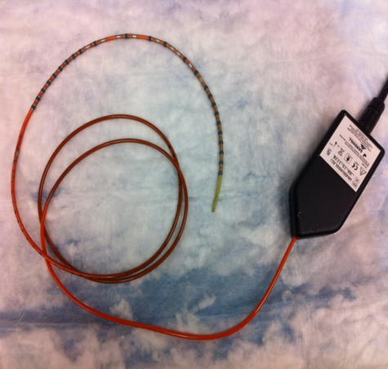
High resolution manometry
Transnasal passage of catheter with pressure sensors into the esophagus
Patient takes 10 wet swallows
Measurements
Esophageal body: Contraction amplitude and coordination (peristalsis)
UES and LES: Basal tone and relaxation during swallows

Slide 6
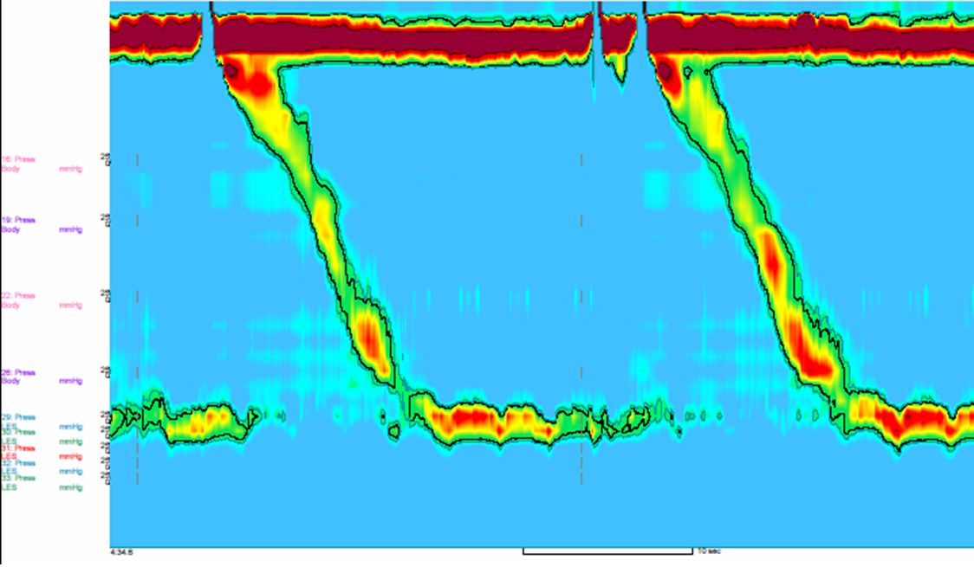
Esophageal manometry
UES relaxation
Basal UES pressure
Esophageal Peristalsis
Basal LES pressure
LES relaxation

Slide 7
Esophageal manometry
NPO 3-6 hrs
Follow calibration and catheter sterilization protocols
Numb nostril with 2% Xylocaine gel
Lubricate the manometric catheter and insert through nasal passage.
Place patient in the supine position
Test swallow and deep inspiration to make sure catheter has traversed the diaphragm
Instruct patients to limit their spontaneous swallow, and then monitor the LES pressure for 5 minutes
Have the patient perform ten 5-mL water swallows
http://www.nature.com/gimo/contents/pt1/full/gimo90.html

Slide 8
Gastroesophageal reflux disease (GERD)
Most prevalent gastrointestinal diagnosis (20%)
Manometry
Assess underlying esophageal dysmotility, anatomical landmarks, and presence of hiatal hernia
Assist in proper placement of pH monitoring probe
Evaluate for contraindications to anti-reflux surgery
Prognosticate outcomes of anti-reflux surgery
Esophageal pH assessment
Document abnormal exposure to acid/reflux event frequency
Allows correlation between patient-reported symptoms and reflux events
Required preop testing to prognosticate response to antireflux surgery
ACG 2013 Guidelines

Slide 9
Diagnostics - esophageal pH assessment
Background
Prevalence of 10-20%, incidence 5 in 1000 person years in the western world
Goals:
Quantify gastroesophageal reflux and correlate with symptoms
Various modalities:
24hr-48hr ambulatory pH
-Bravo wireless capsule
24hr pH/impedance
- Impedance increases the sensitivity of the pH study to 90%
Dent J.et.al. Epidemiology of gastro-oesophageal reflux disease: a systematic review. Gut. 2005
Notes:
excellent sensitivity (77– 100%) and specific city (85 – 100 % ) in patients with erosive esophagitis;

Slide 10
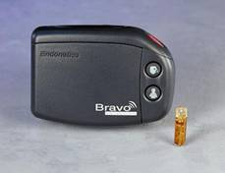
24-hr ambulatory pH monitoring
Transnasal catheter
Esophageal acid exposure (pH <4) detected by pH sensors on probes
Patient records symptoms for correlation, upright/recumbent positioning
Data transmitted to wireless receiver
Wireless capsule allows for longer study periods (Bravo) and better patient tolerability
GI Motility online (May 2006) | doi:10.1038/gimo31 http://www.albynmedical.com/Products/ProductDetail.aspx?ID=47

Slide 11
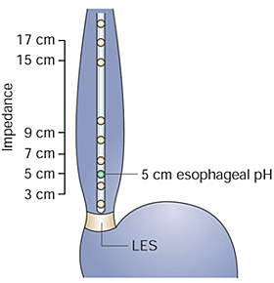
24hr multichannel intraluminal pH-impedance
Transnasal catheter
24-hour study
Reflux detected by changes in intraluminal impedance over distal and proximal channels
Liquid: ↑ conductance => ↓ impedance
pH data classifies reflux as acidic (pH<4) or weakly acidic/nonacidic (pH>4)
Patient records symptoms for correlation, upright/ recumbent positioning
Data transmitted to wireless receiver
GI Motility online (May 2006) | doi:10.1038/gimo31 http://www.albynmedical.com/Products/ProductDetail.aspx?ID=47

Slide 12
Positioning of the MII-pH catheter
Check with your equipment representative and educator regarding calibration protocols
Localize LES
by manometry or upper endoscopy
Place the MII pH catheter 5 cm above the proximal border of LES
ACG Practice Guidelines: Esophageal Reflux Testing 2007

Slide 13
Patient prep for manometry - Medications
Anticoagulation – check with prescribing physician to hold clopidogrel, warfarin, Pradaxa (dabigatran), Xarelto (rivaroxaban), Eliquis (apixaban), etc.. to avoid risk of epistaxis
BP meds: calcium channel blockers such as verapamil, nifedipine and diltiazem, nitrate and nitroglycerin products such as isosorbide can interfere with manometry – prescribing physician to say if these can be held for 1 day prior to testing
Narcotics and benzodiazepines – hold at least 12 hours prior. Can not give Valium (diazepam), Xanax (alprazolam) or Ativan (lorazepam).
Patient should also get instructions regarding insulin if diabetic as they will be NPO.

Slide 14
Patient prep for pH testing
24hr pH/impedance monitoring – referring provider should specify “ON PPI” or “OFF PPI”
Ask about metal allergies: Bravo contains Nickel - can do pH/impedance study instead
“Off PPI”
hold all PPIs for 7 days prior
Hold all H2 blockers (ranitidine, famotidine etc.) for 3 days prior
Hold all antacids like TUMS, Gaviscon, Maalox etc. for 1 day

Slide 15
EGD guided manometry catheter placement
Go over all instructions (both for manometry and pH/impedance) prior to EGD
Only use propofol for EGD (no other narcotics/benzodiazepines)
After propofol turned off, wait at least 30 min or until patient is completely alert and able to follow instructions

Slide 16
Interpretation pH/impedance
Antegrade Flow
Retrograde Flow

Slide 17
Interpretation – Esophageal manometry Chicago classification
Kahrilas, P.; et.al. Neurogastroenterol Motil. 2015

Slide 18
Esophageal manometry
UES relaxation
Basal UES pressure
Esophageal Peristalsis
Basal LES pressure
LES relaxation

Slide 19
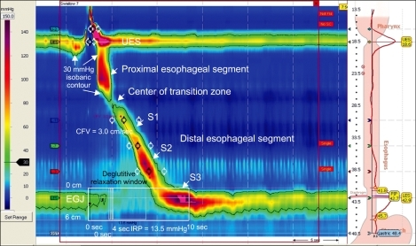
Landmarks
Integrated relaxation pressure (IRP) => LES relaxation
The minimal average pressure during a 3 or 4-second relaxation period at the esophagogastric junction (EGJ)
CC v3.0 advocates use of median IRP (instead of mean IRP)

Slide 20
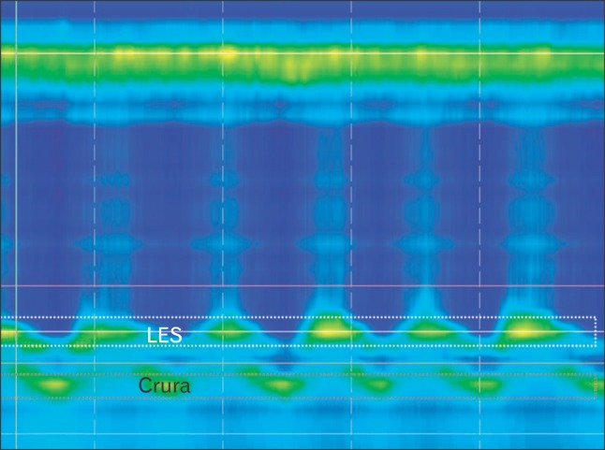
Hiatal hernia
https://www.researchgate.net/figure/232722390_fig8_High-resolution-esophageal-manometry-contour-plot-of-hiatus-hernia-White-dotted-box

Slide 21
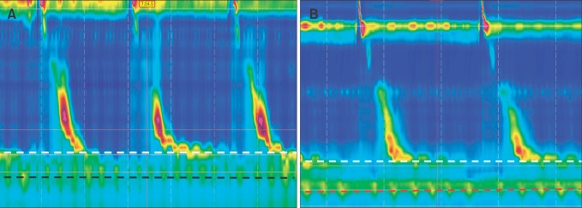
Hiatal hernia
https://www.researchgate.net/figure/232722390_fig8_High-resolution-esophageal-manometry-contour-plot-of-hiatus-hernia-White-dotted-box

Slide 22
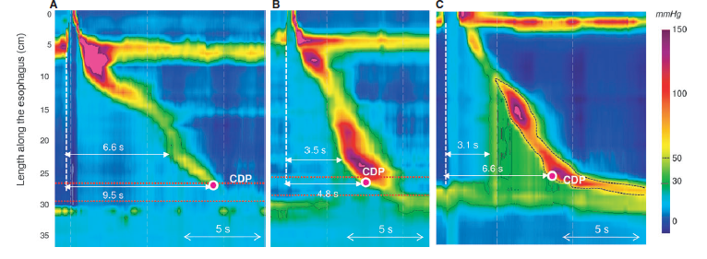
Landmarks
Distal latency (DL)=>Esophageal body peristalsis
Interval from UES relaxation to the contractile deceleration point (CDP)
CDP must be localized to within 3 cm of the LES
< 4.5 s defines a premature contraction

Slide 23
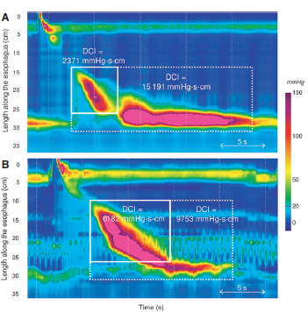
Landmarks
Distal contractile integral (DCI)
=> Esophageal body contraction
Incorporate the LES into the DCI measurement domain if concerned about hypercontractility using existing cutoff value (8000 mmHgscm)

Slide 24
