Slide 1
HEREDITARY GASTROINTESTINAL CANCER SYNDROMES
Yonas Getachew M.D.
Assistant Professor
UTSW Medical Center
April 2017

Slide 2
Topics to cover
Familial adenomatous polyposis (FAP)
Attenuated FAP (AFAP)
MUTYH-associated polyposis (MAP)
Peutz-Jeghers syndrome (PJS)
Juvenile polyposis syndrome (JPS)
Lynch Syndrome (HNPCC)

Slide 3
Most Colorectal Cancer are Sporadic
CRC Risk in Family History
MAP
FAP
HNPCC
Familial
Sporadic
COLORECTAL CANCER

Slide 4
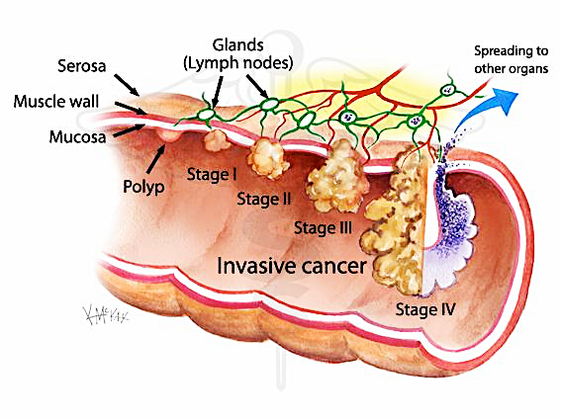
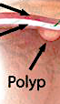
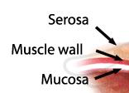
Colorectal Carcinogenesis [ Adenoma Carcinoma Sequence ]
p53
DCC,
Loss 18q
K-RAS
Colon Carcinoma
Large Adenoma
APC
Normal
Aberrant crypt foci
Small Adenoma
Bert Vogelstein Nat Med 2004:10:789

Slide 5
Dominant vs. Recessive
DOMINANT
One mutant allele is enough
50% of the progeny is affected
Every generation is affected
Tumors arise from a second somatic hit
RECESSIVE
Two mutant alleles are required
25% of the progeny is affected
Parents are carriers and are not affected (‘skips a generation’)

Slide 6
FAP

Slide 7
FAP ( Pathogenesis )
Mutations in APC ( cause of loss of regulation )
What is an APC gene ?
APC ( Adenomatous Polyposis Coli )
Long (q) arm of chromosome 5 in band q22.2
tumor suppressor gene
negative regulator that controls beta-catenin concentrations
B-catenin regulates genes that stimulate cell division and cell overgrowth
Mutations in APC lead to loss of β-catenin regulation, altered cell migration and chromosome instability
Long (q) arm of chromosome 5 in band q22.2 (5q22.2)

Slide 8
FAP ( Clinical Manifestations )
Classical: >100 synchronous colonic adenomas, 2nd most common, AD [ 1/3 are de novo ]
Polys are evident by 10-15 yo: mostly in the colon but also in duodenum and SB.
Cancer occurs by ~ 50 yo: 100% in classical FAP [ 1 % of all colon CA ]

Slide 9
FAP ( Clinical Manifestations )
Cancer risk:
  Male = Female
  Colon cancer 100% (5% in the general population)
  Small bowel (mostly periampullary) 3-10% (<1%)
  Thyroid (papillary) 2-12% (1%)
  Pediatric hepatoblastoma 1-2% (<1%)
  Brain 1-2% (<1%)
  Gastric 0.6% (<1%)

Slide 10
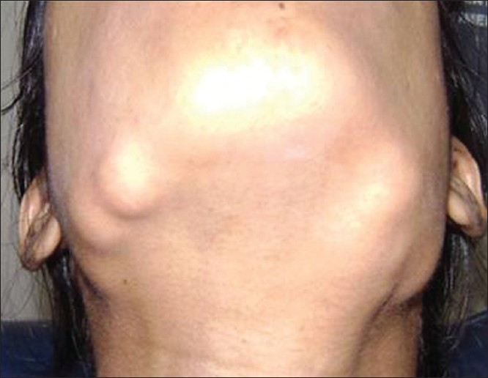
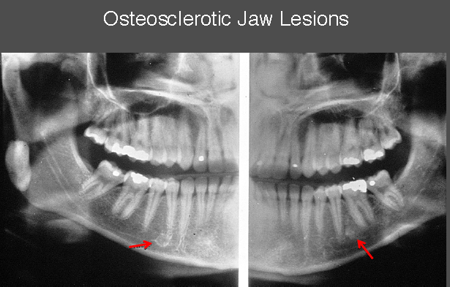
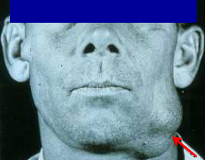
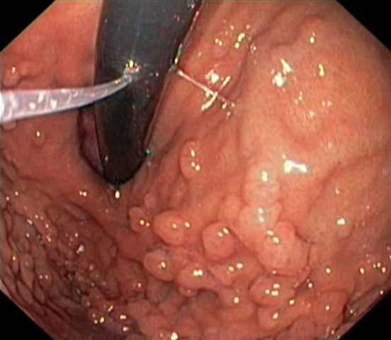
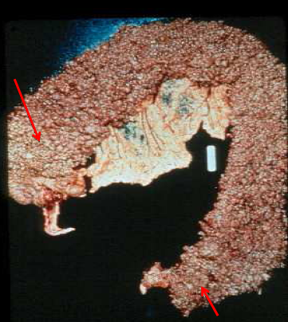
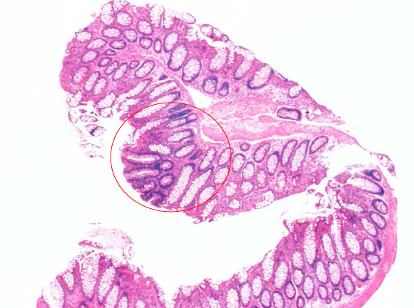
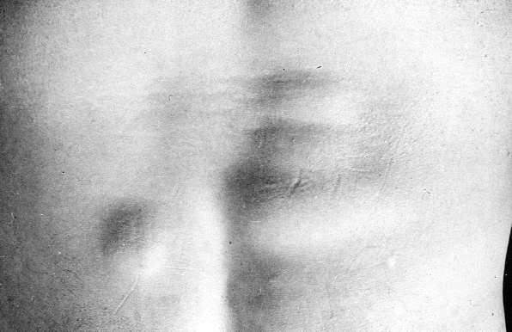
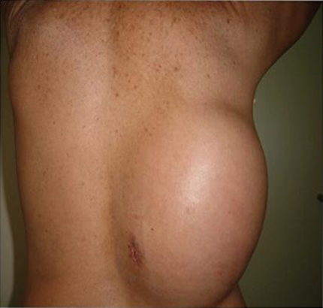
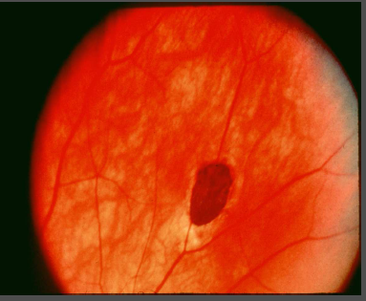
FAP ( Clinical Manifestations )

Slide 11
FAP (Screening)
Persons at risk and first degree relative need gene testing
GI related Clinical Course
Puberty | polyps appear
15 y.o. | onset of polyps
33 y.o. | symptoms appear
36 y.o. | polyposis diagnosis
39 y.o. | colorectal cancer dx
42 y.o. | death from CRC
Colon | Sigmoidoscopy annually; start age 10-12 yr. , q 2yr > 25, q 3yr >35, then ave risk > 50
Duodenum | EGD with side-viewing scope; start age 25-30 (Spigelman stage)
Pancreas | ? Abd US after age 20
Thyroid | Annual thyroid exam start age 10-12 yr. & US
CNS | Annual PE; periodic head CT/MRI
Hepatoblastoma | Annual PE/ hepatic US & AFP ( 1st decade of life )
Pretest genetic counseling
Informed consent
Test affected pedigree member first
If affected mutation is not known or affected member is not available then negative test is inconclusive.
Giardiello FM et al. FAP. In:Bosman FT. WHO Classification of Tumor of the Digestive Tract. Lyon France: IARC 2010

Slide 12
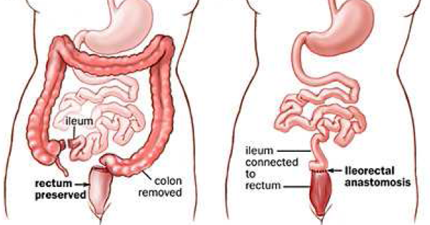
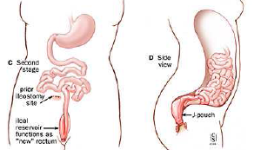
FAP (Management)
Colon: [ 100% ]
  FAP: Flex sig at puberty (10-15), and yearly colonoscopy once polyps noted. Colectomy at >18-20 yo. Ileorectal anastomosis or TPC+IPAA.
  Annual endoscopy with IPAA/IRA required to examine remaining rectal tissue
  Sulindac/NSAIDS: delay rectal/duodenal adenomas but does not prevent cancer

Slide 13
AFAP

Slide 14
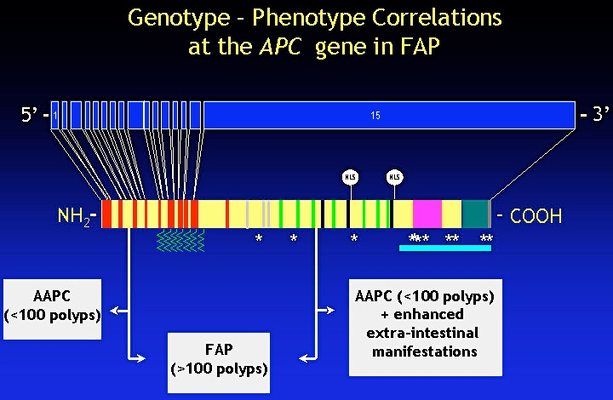
AFAP ( Pathogenesis )
Mutations in APC ( cause of loss of regulation )
APC (5’ and 3’ of the gene)

Slide 15
AFAP ( Clinical Manifestations )
10-100 synchronous adenomatous polyps
Can develop extra colonic manifestations
Most are R-sided lesions
Same as FAP

Slide 16
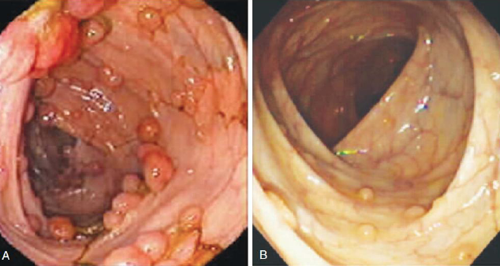
AFAP ( Clinical Manifestations )
Cancer risk:
- Colon cancer [ 70 % vs. 100 % ]
  Presentation (51 y.o. vs. 39 y.o.)
  Similar small bowel risk (periampullary)
  - Thyroid (papillary) 1-2%

Slide 17
AFAP ( Screening and Management )
Colon:
  Colonoscopy at 20-25 and yearly thereafter. Colectomy not necessary for most patients.
Duodenum:
  EGD with side viewing scope starting at 25-30 yo
  Interval of surveillance depends on findings (6 mo-4 yrs.)

Slide 18
MAP

Slide 19
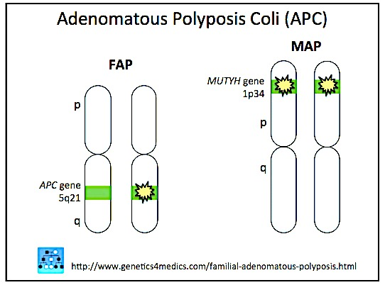
MAP ( Pathogenesis )
Mutation in MUTYH genes
MUTYH genes are genes involved in base excision repair gene
Mutation accumulates in APC gene
~ 1-2% of persons of European descent have a mutation in one of their MUTYH genes
AR (skips a generation)

Slide 20
MAP ( Clinical Manifestations )
20-100 synchronous adenomatous polyps, typically less than 500
Adenomas and SSAs in the colon (100%)
Cancer risk:
  Colon (40-60%) - less penetrant and later presentation than FAP
  occurs by ~ 50 yo
  Some CRC presenting without concurrent polyps
  Similar small bowel risk
  No extra intestinal tumors, compared to FAP
    No osteomas, CHRPE, desmoids, thyroid CA
    Can get breast, ovarian, urinary and skin cancers
Screening and management is the same as AFAP
Vogt et al. Gastroenterology, 2009: 137: 1976.

Slide 21
Hamartomatous Polyposis Syndrome

Slide 22
Peutz-Jeghers Syndrome
(PJS)

Slide 23
PJS ( Pathogenesis )
Mutation in STK11/LKB1 gene ( Chromosome 19 )
Inhibit inappropriate expansion of tumor cells

Slide 24
PJS ( Clinical Manifestations )
AD
Distribution of polyps:
  Small bowel 96%
  Colon 27%
  Stomach 24%
  Rectum 24%
Presenting symptoms
  50% present by age 20
  Intussusception, anemia, rectal bleeding, or vague abd pain

Slide 25
PJS ( Clinical Manifestations )
Diagnosis - Two or more typical hamartomatous polyps + pigmented spots. +/- family hx of PJS
Polyps are hamartomas with arborizing infoldings and muscularis mucosae extensions.
Extensive cancer risk: > 80 % life time
  Colorectal 39% (5% ~ general population)
  Stomach 29% (<1%)
  Small bowel 13% (<1%)
  Pancreas 11–36% (1.5%)
  Breast 32–54% (12.4%)
  Ovarian 21% (1.6%)
  Uterus 9% (2.7%)
  Cervix (adenoma malignum) 10% (<1%)
  Testicular (Sertoli cell tumors in kids) 9% (<1%)
  Lung 7–17% (6.9%)

Slide 26
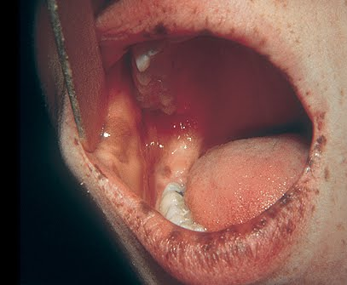
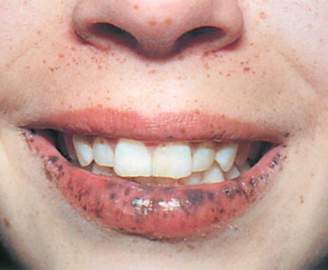
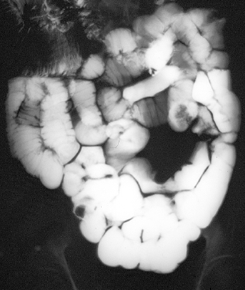
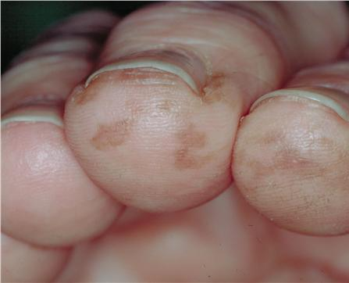
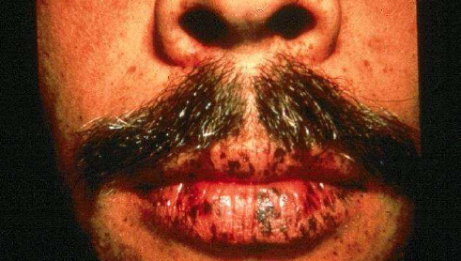
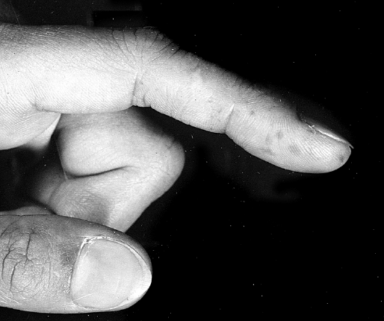
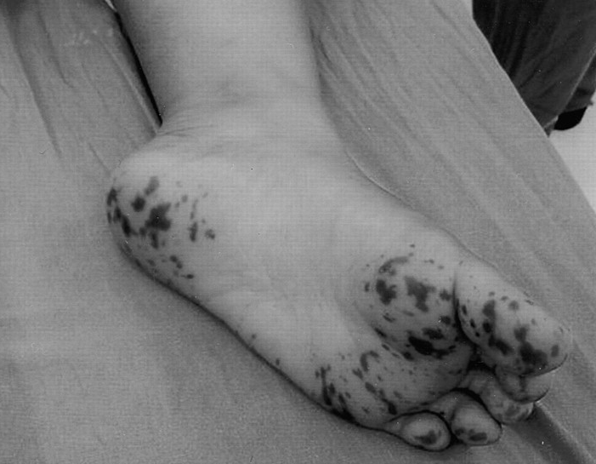
pigmented spots
PJS ( Clinical Manifestations )
Intussusception

Slide 27
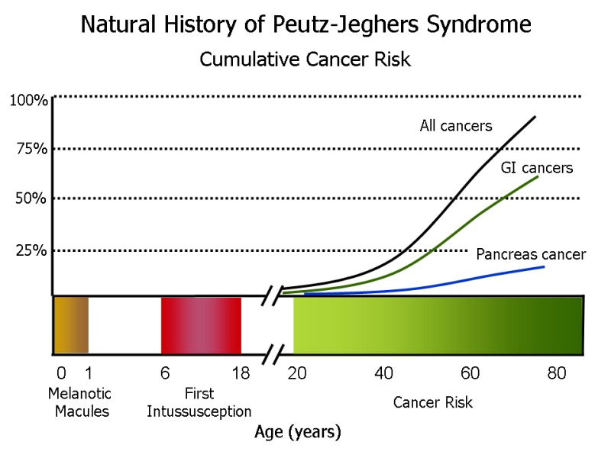
Riegert-Johnson D., et al. Cancer Syndromes. Bethesda (MD): National Center for Biotechnology Information (US); 2009-.

Slide 28
PJS (Screening and management )
EGD/colonoscopy/Capsule age: 8 yo – repeat at 18 if negative, earlier if positive; q 3 yrs.
  Polypectomy of all lesions > 0.5-1 cm
  Bowel resection for unresectable /numerous polyps
  Intussusception requiring surgery is a common problem
MRCP or EUS Q 1-2 years by age 25-30
Breast MRI / Gyn exam + US: age 25 yo and q 1yr
Annual testicular exam /US from childhood until end of puberty
Lung surveillance UNCLEAR
Zbuk KM: Nat Clin Pract Gastroenterol Hepatol 4: 492-502: 2007
Giardiello FM. PJS. In: Rodriquez-Bigas MA. Hereditary Colorectal Cancer. New York: Springer, 2010.

Slide 29
Juvenile Polyposis ( JPS )

Slide 30
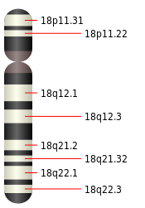
JPS ( Pathogenesis )
Mutation in SMAD4 /BMPR1A gene
SMAD 4 is controlled by TGFβ pathway
  regulates cell growth and division
Thus, loss of SMAD 4 creates un-regulated cell division

Slide 31
JPS ( Clinical Manifestations )
1:100,000
Up to 50% are de novo but able to pass to children
15 % have congenital cardiac abnormalities and a subset have GI and/or pulmonary AVMs
Age of presentation ( usually prior to age 20 )
Presentation: Some patients may present with extensive polyposis resulting in protein losing enteropathy, other may present with unexplained anemia.

Slide 32
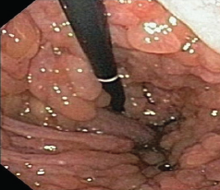
JPS ( Clinical Manifestations )
Adenomatous changes can be seen in some polyps, giving rise to cancer
Distribution of polyps:
  Stomach 14%
  Duodenum 7%
  Jejunum and ileum 7%
  Colorectal 98%
Zbuk KM: Nat Clin Pract Gastroenterol Hepatol 4: 492-502: 2007

Slide 33
JPS ( Clinical Manifestations )
Overall risk of any GI CA ~ 50%
  Colorectal ~70% (5% in the general population)
  Stomach 30% for SMAD4 mutations (<1%)

Slide 34
JPS ( Screening and Management)
Colon:
  Colonoscopy at 12 and every 1-3 y thereafter. Polypectomy of all lesions > 0.5 cm.
  Colectomy with IRA or TPC + IPAA may be necessary.
Stomach/duodenum:
  EGD at age 12 and every 1-3 yr thereafter. Polypectomy of all lesions > 0.5 cm
Rest of small bowel: ‘periodic’ capsule or CTE
  Extensive duodenal polyposis, unexplained anemia, protein-losing enteropathy
No specific rec for pancreas

Slide 35
Lynch syndrome

Slide 36
Introduction
This is the most common inherited form of colon cancer susceptibility.
It accounts for about 3-5% of the total burden of colon cancer.
AD with incomplete penetrance
100,000 -300,000 Americans have Lynch Syndrome
The syndrome is caused by mutations that disrupt expression of genes involved in DNA mismatch repair.

Slide 37
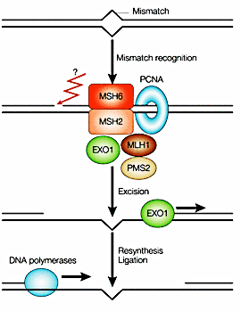
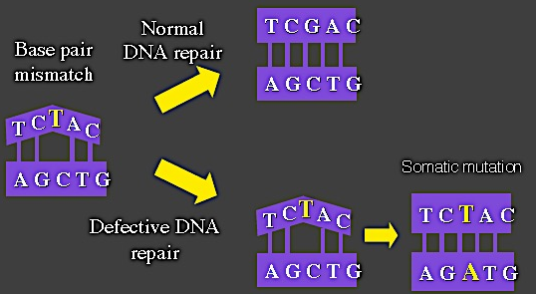
Mismatch repair (MMR)
MMR corrects polymerase errors that spontaneously occur during DNA replication
correct errors by forming a complex that binds to the mismatched section of DNA

Slide 38
Genetics
Lynch is a dominant syndrome due to germline mutations in one allele of any of the following genes:
  MLH1 (1/3 of cases) [ classic & 30% are missense ]
  MSH2 (1/3) [ classic form ]
  MSH6 (1/6) [ attenuated form & MSI-L cancers ]
  PMS2 (1/6) [attenuated form & MSI-H cancers ]
1:1,000- 1:3,000 are carriers of MMR gene mutations

Slide 39
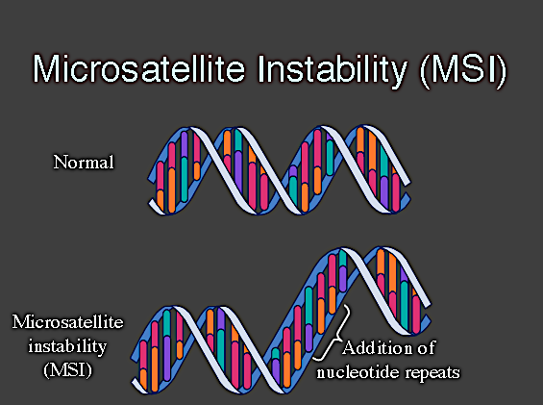
Microsatellite Instability (MSI)
repeating units of one to six base pairs in length.
repeated sequences of DNA
represents phenotypic evidence that MMR is not functioning normally
MSI does not seem to have any clinical effect [a marker of faulty DNA repair ]
Boland CR, et al. Cancer Res. 1998;58:5248-5257.
Giardiello FM, et al. Gastroenterology. 2001;121:198-213.

Slide 40
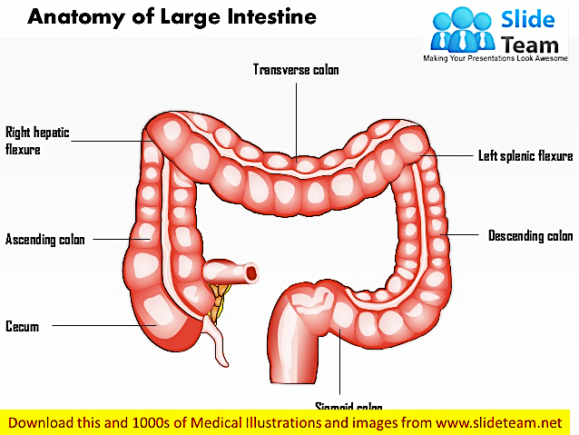
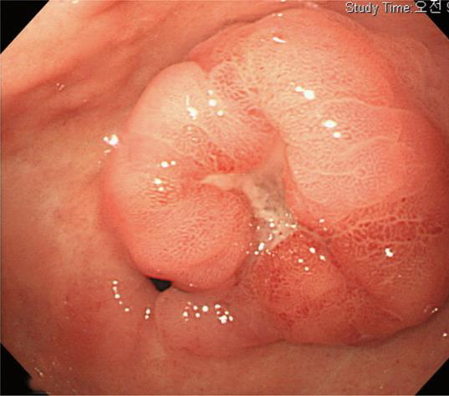
Colorectal cancer
HNPCC Right sided (60-80%)
~ 40 YO
Pathology
Colon cancers in Lynch syndrome are predominantly right sided, large, medullary growth pattern, mucinous, and elicit a strong inflammatory response (so-called ‘Crohn’s-like’ reaction).
Sporadic Left sided (70%)
~ 60 YO
Age of Diagnosis
% of incidence
Age in Years

Slide 41
Revised Bethesda Guidelines for Testing Colorectal Cancers for Microsatellite Instability
Colorectal tumors should be tested for MSI in individuals meeting any of the following
CRC diagnosed at age <50 years
Presence of synchronous , metachronous CRC, or other HNPCC-associated tumors regardless of age (Endometrial, stomach, ovarian, pancreas, ureter and renal pelvis, biliary tract, and brain tumors, sebaceous gland adenomas and keratoacanthomas in Muir-Torre syndrome, and carcinoma of the small bowel )
CRC with the MSI-H histology diagnosed at age <60 years (Presence of tumor infiltrating lymphocytes, Croh’s-like lymphocytic reaction, mucinous/signet-ring differentiation, or medullary growth pattern. )
CRC or tumors associated with HNPCC-related tumors diagnosed in ≥1 first-degree relative at age <50 years
CRC or tumors associated with HNPCC-related tumors diagnosed in ≥2 first- or second-degree relatives at any age
* Intended to ID patients for MSI testing. NOT a diagnostic criteria for LYNCH.
* If a tumor is not available, germline DNA testing should be considered.

Slide 42
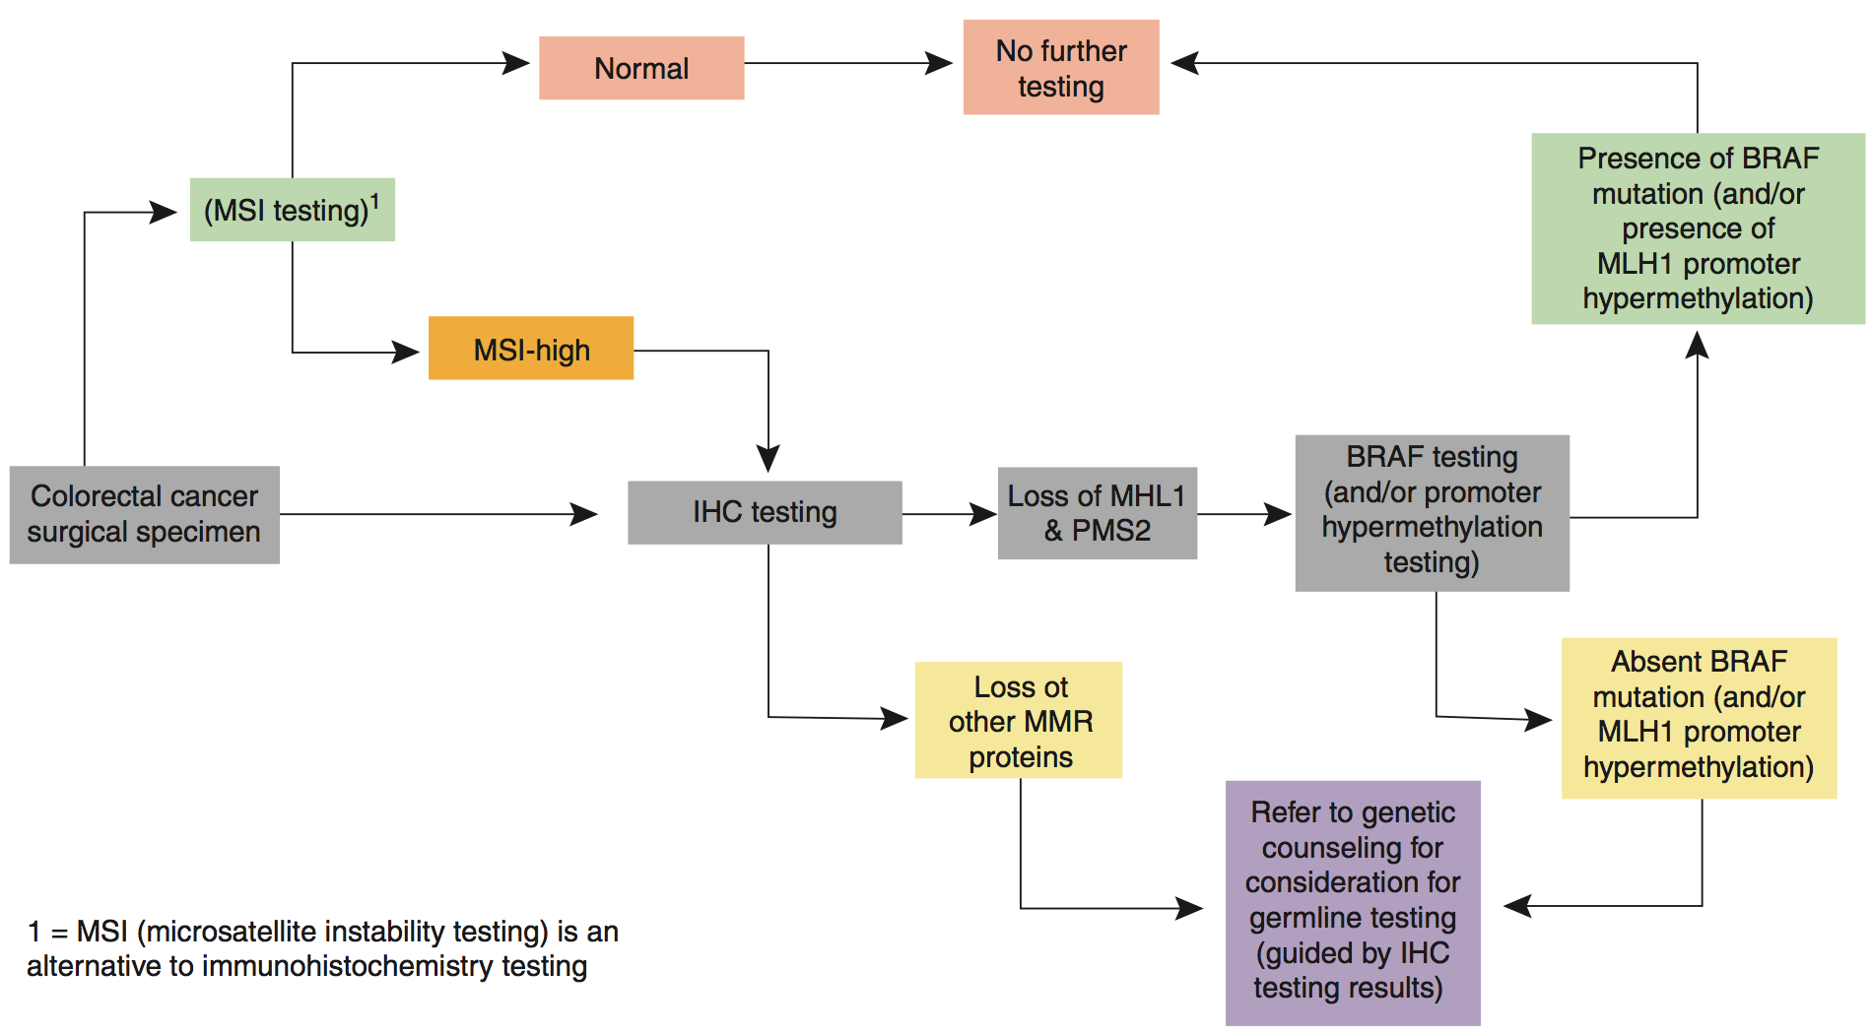
Universal screening by tumor testing

Slide 43
Management for Lynch
Colon cancer prevention:
  yearly colonoscopy surveillance starting at age 20-25 if family refuses genetic testing
  Family member with MMR (-), q 5yr colonoscopy starting 10 yrs from youngest family members
  Family member with MMR (+), consider prophylactic colectomy
  Aspirin (once daily) reduces the risk of cancer and is recommended ( CAPP2 trial [ long term 600mg/day decreased CRC by 63% ] and CAPP3 determine optimal dose )
Colon cancer treatment:
  subtotal colectomy and ileorectal anastomosis should be offered.
  Need annual rectal surveillance ( 12 % over 12 years )
  MSI-high tumors do not derive as much benefit from commonly used regimens (containing 5-FU)
Gastric cancer prevention:
  EGD for high risk individuals (coming from endemic areas, family history)

Slide 44
Management for Lynch
Urothelial cancer prevention:
  yearly screening with urine cytology (looking for dysplastic cells) and urinalysis (to detect microscopic hematuria)
Endometrial and ovarian cancer prevention:
  available surveillance tests are inadequate
  prophylactic TAH+BSO is recommended after completing family or age 40
Skin: yearly dermatologic evaluation for sebaceous gland tumors
Surveillance for other tumors is not recommended since strategies for early detection are not optimal and absolute risk is relatively low.

Slide 45
Summary and Key points

Slide 46
Summary and Recommendations
Most (> 70 %) CRC are sporadic
Most HCRCs are autosomal dominant
Good family history is essential for diagnosis of these syndromes

Slide 47
Identifiable Familial Syndromes Confer High Cancer Risk
Syndrome | Lifetime Cancer Risk
Familial Adenomatous Polyposis (FAP) | 100% for CRC Up to 12% for Duodenal Cancer
Attenuated FAP | 70% for CRC
MYH Polyposis | 40-60% for CRC
Peutz Jegher’s Syndrome | 39% for CRC 54% for Breast
Juvenile Polyposis | 40-70% for CRC >20% for Stomach/Pancreas/Small Bowel
Lynch Syndrome (Hereditary Nonpolyposis CRC) | 50-80% for CRC 50% for Uterine Cancer

Slide 48
Identifiable CRC Syndromes Require Specialized Management
Syndrome | Management
FAP | Total colectomy Screen for ampullary adenoma Screen for thyroid cancer Screen children age 10 to 15
Attenuated FAP | Total colectomy (if CRC) Screen for ampullary adenoma
MYH Polyposis | Total colectomy (if CRC) Screen for ampullary adenoma
Lynch Syndrome | Consider subtotal colectomy vs. segmental colectomy Consider hysterectomy/oophorectomy Colonoscopy q 1-2 yrs after age 20-25 for affected relatives

Slide 49

Questions/ Comments ???

