Slide 1
Endoscopic therapy of dysplastic Barrett’s esophagus: to Burn, Freeze, or Cut?
Jayaprakash Sreenarasimhaiah, MD Director of Advanced Endoscopy
Medical City Dallas Hospital
Texas Digestive Disease Consultants

Slide 2
Overview
Background
Indications for endoscopic therapy in BE
Endoscopic mucosal resection
Photodynamic therapy
Argon Plasma Coagulation
Radiofrequency ablation
Cryospray ablation
Endoscopic treatment of esophageal carcinoma

Slide 3
Background
Barrett’s esophagus is primary precursor for esophageal adenocarcinoma
In US, esophageal adenoca increased 600% between 1975 and 2001
Barrett’s may arise from:
Transdifferentiation of squamous esophageal cells from acid
Migration of cells from gastric cardia
Differentiation of pleuripotent stem cells under influence of reflux contents

Slide 4
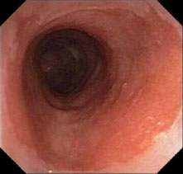
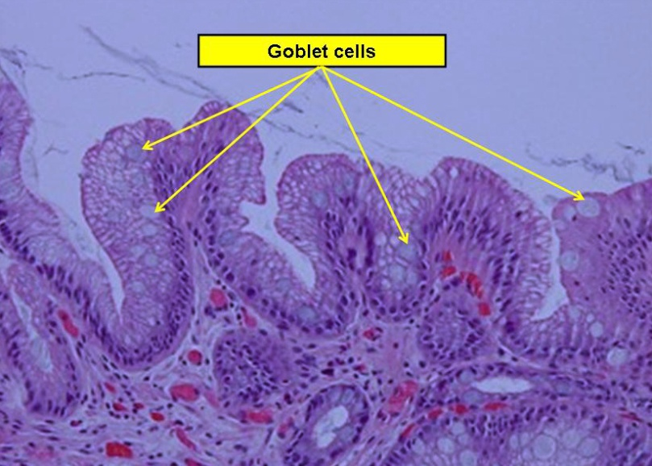
Background
Histology shows specialized intestinal metaplasia with goblet cells
Progression from metaplasia to LGD to HGD to adenocarcinoma

Slide 5
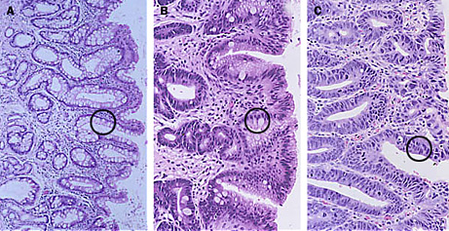
Background
Risk of BE to carcinoma is 0.5% per patient year
Risk of LGD to HGD is 0.5 to 13% per patient year
Quality of evidence is low
LGD is often overcalled
Consideration of sampling error
Risk of HGD to carcinoma is 6% per patient year
Some studies show 30% risk within 5 years

Slide 6
Background
Risk factors for Barrett’s
GERD – increased with duration
Male sex (2:1)
Caucasian race
Increased age >50
Smoking
Increased abdominal adiposity and BMI
Long-standing GERD
Often inadequately treated
Symptoms of GERD improve in later stages
Optimiize PPI treatment for GERD and esophagitis therapy
Anti-reflux surgery not indicated as prevention of BE to neoplasia

Slide 7
Indications for therapy in Barrett’s esophagus
AGA medical position statement (2011)
No dysplasia should be followed in 3 – 5 years
Dysplasia should be confirmed by a second pathologist
LGD should be followed in 6 to 12 months
HGD should be offered endoscopic therapy with RFA, PDT, or EMR
EMR should be performed first for any visible mucosal or raised irregularity to determine T stage of neoplasm
HGD not treated should be followed in 3 months
Esophagectomy has higher morbidity but may be an option in up to 20% of HGD

Slide 8
Indications for therapy in Barrett’s esophagus
ACG practice guidelines (2015)
Biopsies at 2cm interval (nondysplasia) and 1cm interval (prior dysplasia)
LGD – confirm with repeat EGD in 3 – 6 months and 2nd pathologist
LGD should be offered endoscopic ablation if no life-limiting comorbid illness; alternatively, surveillance in 12 months)
Indefinite for dysplasia – repeat in 3 – 6 months after PPI
PPI only once daily for chemoprevention
Nodule seen in Barrett’s – treat with EMR for both dx and tx purpose
Nondysplastic BE should not be given endoscopic ablation therapy- repeat EGD in 3 to 5 years for surveillance
Shaheen, et al. Amer J Gastro. Nov 2015

Slide 9
Indications for therapy in Barrett’s esophagus
ACG practice guidelines (2015)
Routine EUS prior to EMR of nodular or dysplastic BE is not recommended
HGD should be offered endoscopic ablation if no life-limiting comorbid illness
T1a EAC can be treated with EMR alone
T1b EAC with well-differentiation and no lymphovascular invasion – EMR may be sufficient if esophagectomy is high-risk; consider EUS for nodal assessment
Following ablation of LGD, repeat EGD in 6 months then annually
Following ablation of HGD or IMC, repeat EGD every 3 months for 1st year, every 6 months for 2nd year, then annually
Shaheen, et al. A J Gastro. Nov 2015

Slide 10
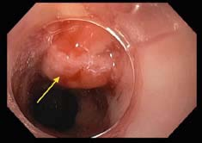
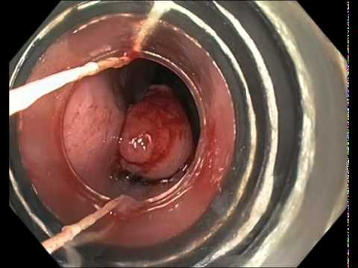
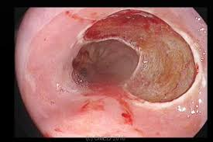
Endoscopic Mucosal Resection (EMR)

Slide 11
Endoscopic Mucosal Resection (EMR)
Treatment of nodules, dysplastic and IMca
Allows definitive histologic dx as well as therapeutic/curative
Prior to EMR, white light and NBI comparison
EUS has not been shown to add benefit prior to EMR
Prospective trial of 279pts
Tech success in 96.5% and remission of 94.5%
Overall major complications of 0.6%
Pech et al. Gut 2008

Slide 12
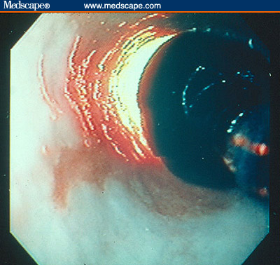
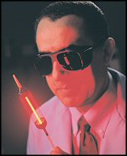
Photodynamic therapy
More than 20 years of experience
Photofrin (5-aminolevulinic acid) injected, red light activation
Stricture rate of 36%
Expensive, time consuming, sunlight sensitivity
Can cover large area but most data shows only downstaging of metaplasia and dysplasia rather than eradication

Slide 13
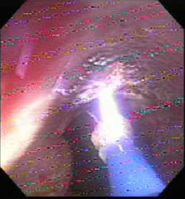
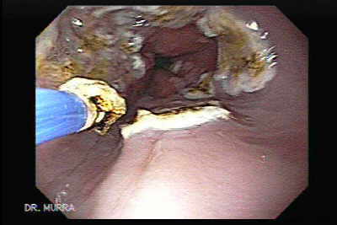
Argon Plasma Coagulation
ERBE generator – 2L/min at 65W
Covers 2mm area at a time, depth with time
91% of patients experience pain and have transient dysphagia and odynophagia
2004 study by Kelty, et al. between PDT v APC, showed 50% v 97% eradication of BE (n=32 each)
Time consuming

Slide 14
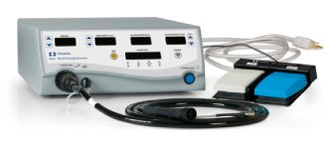
Radiofrequency ablation (RFA)
Barrx (Covidien)
Halo 360 balloon
90-focal catheter
60-focal catheter
Ultra long 90-focal
Channel RFA catheter

Slide 15
Radiofrequency ablation (RFA)
FDA approved in 2005;
Direct visualization, contact method
Depth of 500 microns
CR-IM 85% at 2 years
CR-HGD 88 – 94%
CR-LGD 87 – 95%
Flat dysplasia only; not indicated in nodular disease or cancer
Stricture rate between 0 – 8% reported, overall <6%
Perforation rate 0.02% and no reported deaths

Slide 16
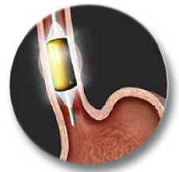
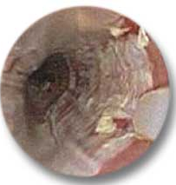

Slide 17
Outcomes of RFA for dysplastic BE
RCT of 127pts (AIM dysplasia trial)
127 pt with dysplastic BE to receive either RFA or sham tx
CRE-LGD 90.5% v 22% control
CRE-HGD 81% v 19% control
CRIM 77% v 2.3% control
Development of EAC – 1.2% v 9.3% control
Buried glands in 3.9% long-term
Shaheen et al. NEJM. May 29,2009

Slide 18
Outcomes of RFA for dysplastic BE
Durability of RFA for eradication of BE
US RFA registry – 1631 pts with mean 2.4yrs f/u
After initial CE-IM, 20% recurred with dysplasia
86% of recurrence was NDBE or indeterminant
6% had progression of original histology
Mean length or recurrence was 4cm
Suggests long-term surveillance after ablation needed
Pasricha, et al. Clin Gast Hepatol. 2014 Nov.

Slide 19
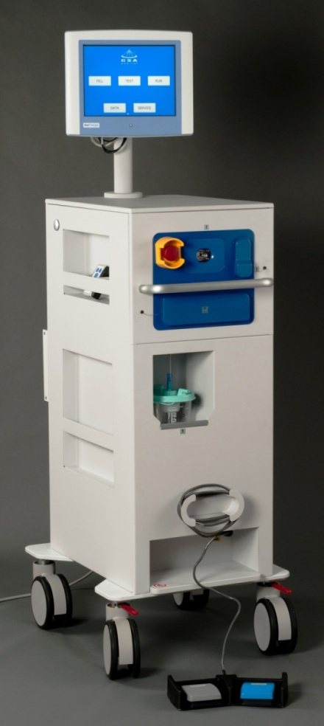
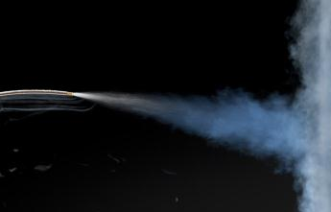
Liquid nitrogen cryospray ablation
CSA medical
Physician-controlled
Direct visualization, noncontact
Low-pressure (2- 3 psi) liquid nitrogen gas
Uniform, nonpulsed flow
New flexible catheter for retroflexion

Slide 20
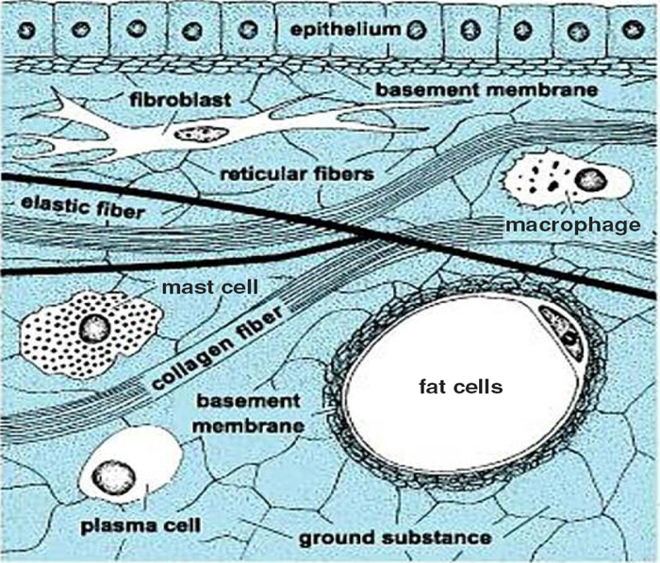
Pathophysiology of cryoablation
Freeze-thaw cycles
Extreme cold (-196⁰C) to flash freeze tissue
Traps maximum water within cells and instantly freezes
Ice formation and membrane disruption – cell necrosis
Cellular contents more susceptible to freeze injury than stromal components due to water content
Intracellular collagen matrix remains intact - framework

Slide 21
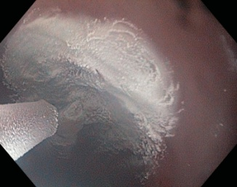
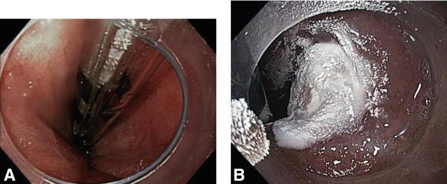
Cryospray ablation technique
Decompression catheter placed into stomach
New system with passive and active venting/suction
Use of a clear cap
Treat 1/3 circumference
4-5cm length
20 secs per site x 2 cycles
30 sec per site x 2 cycles in IMC or EAC

Slide 22
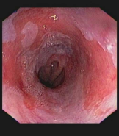
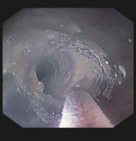
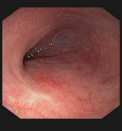
Case Presentation
69 y.o. male with 6cm Barrett’s with HGD
COPD, CAD with stent on anticoagulation, HTN
Taking esomeprazole 40mg bid
INR 2.2

Slide 23
Outcomes of cryoablation for dysplastic BE
98 pts – HGD (mean age 65.4 yrs, 83% M, mean length 5.3cm)
333 treatments (3.4 per pt)
No perforations
3 pts with strictures
2 developed chest pain treated with narcotics
60 pts completed all planned cryo txs
58 (97%) had complete eradication of HGD
52 (87%) had complete eradication of all dysplasia
34 (57%) had complete eradication of intestinal metaplasia
Subsquamous BE found in 2 (3%)
N Shaheen, et al. Gastrointest Endosc. 2010:71(4):680-5

Slide 24
Outcomes of cryoablation for dysplastic BE
17 pts with HGD
Complete response (CR) for HGD 94%
CR for all dysplasia 88%
CR for intestinal metaplasia 53%
7 pts with intramucosal or stage I esophageal cancer
Complete regression of HGD and/or cancer in 100%
32 patients followed between 24 – 57 months
CR-HGD – 97% at 24 months
CR-IM – 84% at 24 months
Greenwald et al. Dis Esophagus. 2010;23(1):13-19
Greenwald, et al. GIE. 2013

Slide 25
Outcomes for dysplastic BE
Retrospective analysis of 33 patients who completed cryoablation therapy
20 HGD (61%)
3 HGD (9%) plus IM carcinoma
10 (30%) persistent long-segment LGD on two endoscopies 6 months apart
Mean age 65.3 yrs, 76% male
Mean length of BE 5.8cm
Mean number of sessions 2.4
Mean followup 12.5 months (range 6 – 36 )
1 died of unrelated causes; 1 lost to f/u due to insurance

Slide 26
Outcomes for dysplastic BE
Retrospective analysis of 33 patients who completed cryoablation therapy
100% eradication of HGD
1 pt with LGD (originally had HGD)
CR-IM in 88%
1 (3%) with recurrence after ablation to HGD/intramucosal cancer
Of 3 with intramucosal cancer (T1), 2 treated successfully with cryo + EMR, 1 with cryo alone
Complications
Significant chest pain requiring narcotics in 0%
No perforations
No admissions
Stricture requiring single balloon dilation session – 2 (6%)
Sreenarasimhaiah, et al. J Gastro Dig Syst. 2014

Slide 27
Recurrent disease after ablation
Single-center, retrospective study
36 pts (mean age 62, 92% men) ablated for HGD
11 pts developed recurrent disease at mean of 6.5 months
3 developed a second recurrence
10 recurrences (71%) were identified below the NSCJ in 9 patients
HGD (4), LGD (2), IM (4)
6 recurrences within the treated esophagus in 5 pts
Intramucosal cancer (1), HGD (1), IM (4)
2 pts had recurrence at both
33/36 (92%) achieved CR after retreatment
LGD (1), IM (2)
Halsey KD et al. Endoscopy 2011;43(10):844-8

Slide 28
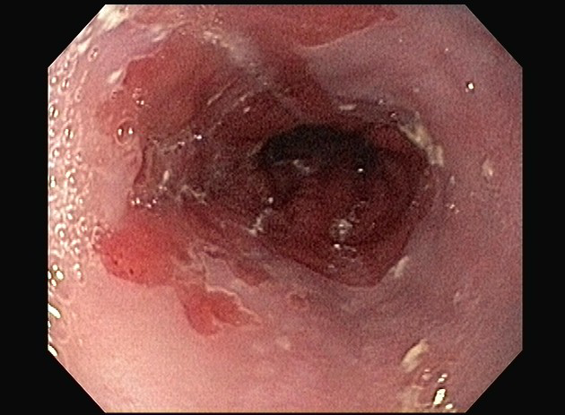
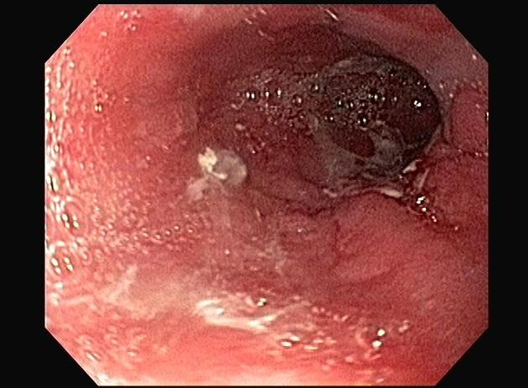
Cryospray ablation after failed RFA therapy
Case Presentation
63 year old male with BE of 9cm length and HGD
Underwent 3 successive treatments with Barrx Halo RFA at outside hospital
Developed severe discomfort and was hospitalized for chest pain overnight after 3rd treatment
EGD 3 months later:

Slide 29
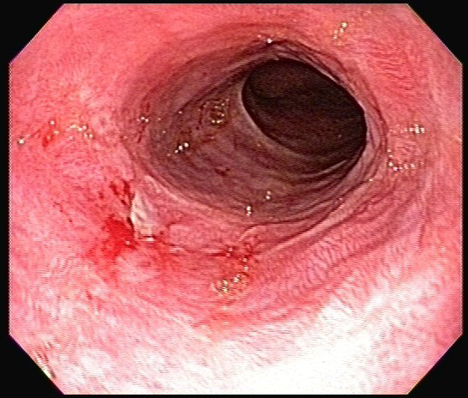
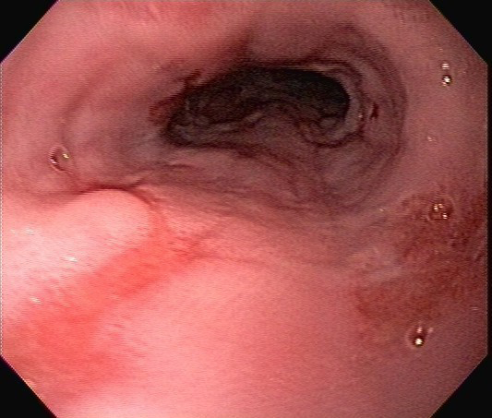
Cryospray ablation after failed RFA therapy
Post therapy appeared improved
6 month follow up showed erosions and few spots of Barrett’s type epithelium
Biopsies showed focal high-grade dysplasia v intramucosal carcinoma

Slide 30
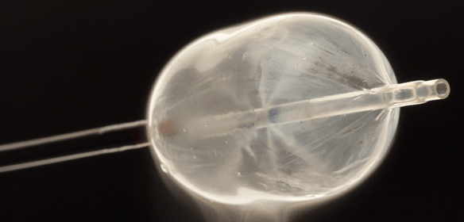
Cryoballoon Focal Ablation System (CbFAS)
Drawbacks to both RFA and cryoablation
- need for sizing, imprecise contact, pain
- need for venting cath, multiple steps
C2 therapeutics (Redwood, CA)
2015 received 510(k) FDA premarketing clearance
Approved in regions of Western Europe and select US trials

Slide 31
Cryoballoon Focal Ablation System (CbFAS)
Safety and feasibility study
39 pts tx with 1 – 2 ablations of 6, 8 , or 10secs
62 ablations with 56 having technical success
6 failed due to device malfunction and/or anatomic issues
27% had mild pain, no major adverse events
No strictures at 8 week follow-up
Neosquamous regenerationseen in 60% (6 sec), 82% (8 sec), and 100% (10 sec)
Scholvinck et al. Endoscopy. 2015 Dec.

Slide 32
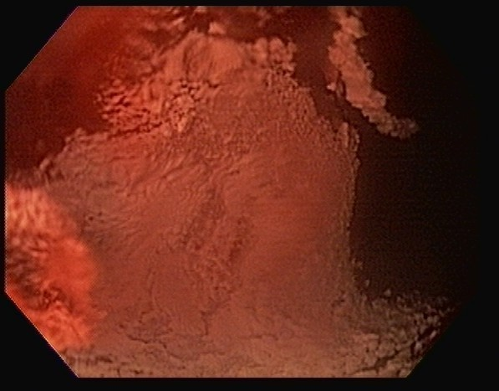
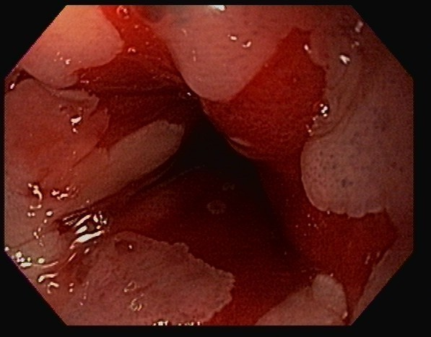
Combined therapy – EMR and ablation
77 year old male with 11cm Barrett’s with HGD
Otherwise healthy except HTN, DJD
Esomeprazole once daily
Surveillance biopsies show multiple areas of high-grade and low-grade dysplasia
Distal esophagus nodule with HGD – removed by cryo and EMR in same setting

Slide 33
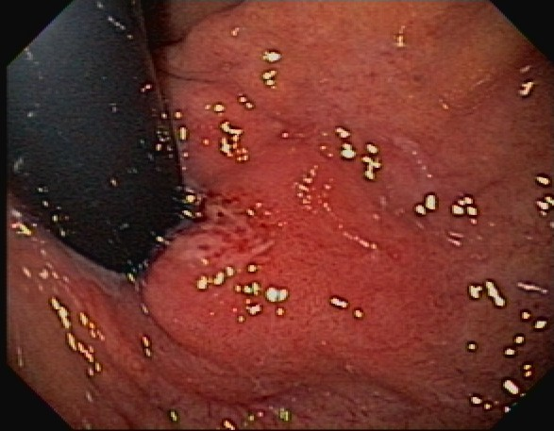
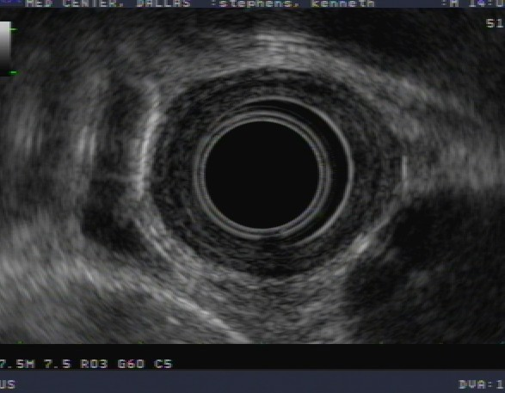
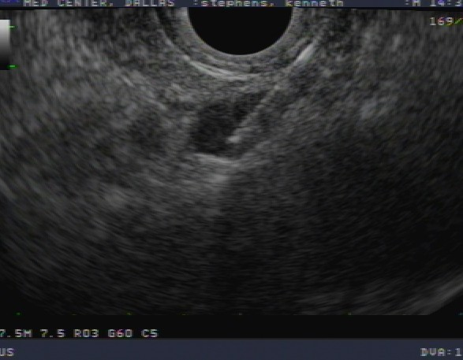
Post ablation IMC in nodule at GE junction and cardia

Slide 34
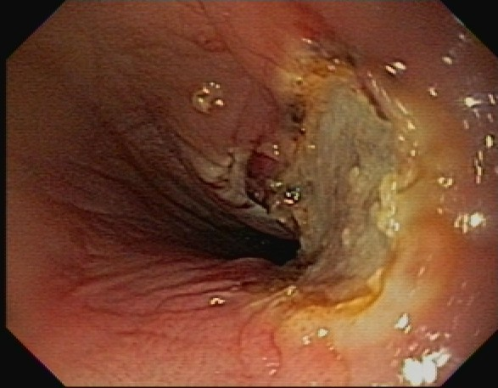
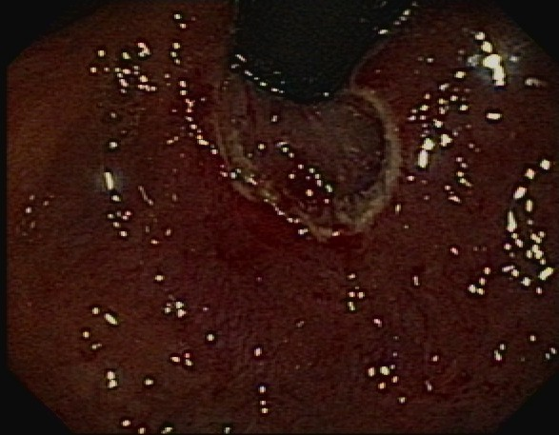
Endoscopic mucosal resection (EMR) combined with cryoablation therapy

Slide 35
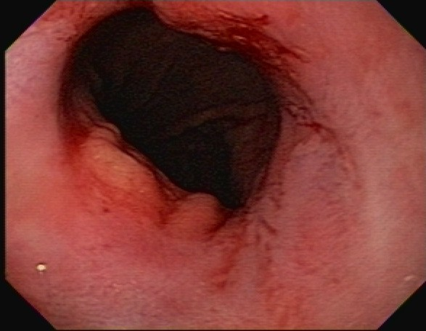
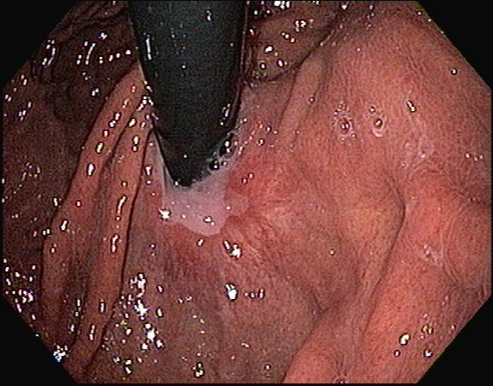
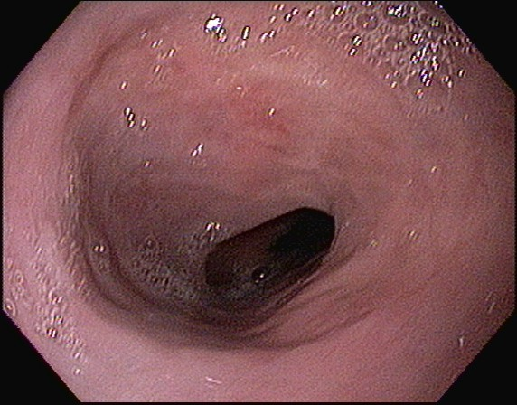
Follow-up after EMR/cryo
Follow-up at 2 yrs

Slide 36
Endoscopic ablation in esophageal cancer
RFA not indicated in treatment of esophageal cancer
Cryospray ablation
Curative therapy in select intramucosal or T1 tumors
Debulking of tumor as bridge for further therapy or palliation
Treatment of tumor ingrowth into stent

Slide 37
Applications in esophageal adenocarcinoma
Author | N | Histology | Mean length | Mean # of treatment | Mean f/u (months) | CR cancer
Greenwald et al. | 46 | T1a - 24 T1b - 10 T1 - 2 T2 - 10 | 4 | 3 | 10.6 | T1a – 75% T1b – 60% T1 – 72% T2 – 30%
Dumot et al. | 5 | IM cancer - 5 | 3.8 | 4 | 12 | 40%

Slide 38
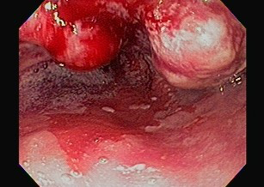
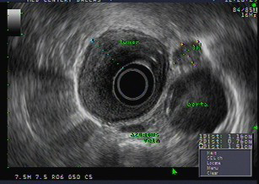
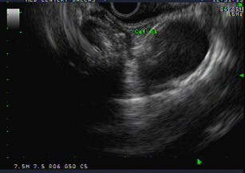
Case Presentation
77 year old male with dysphagia and weight loss
EGD shows bulky, nearly obstructing lower esophageal mass
CT shows no liver mets
Patient is offered further staging and surgical referral
Patient refuses surgery and undergoes chemotherapy
Dysphagia is still present

Slide 39
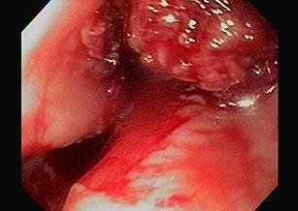
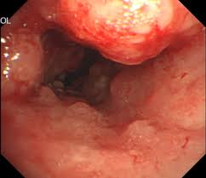
Case Presentation
cryotherapy post cryotherapy
follow-up at 8 weeks

Slide 40
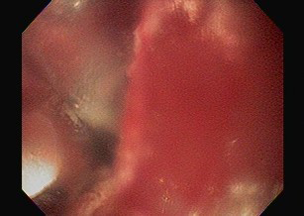
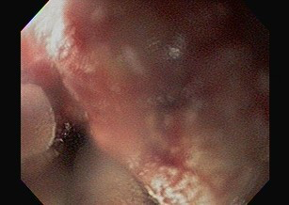
Case Presentation
58 year old male with esophageal adenocarcinoma
Underwent partial esophagectomy with gastric pullup
Adjuvant chemoradiation therapy
11 months later, progressive dysphagia – liquids only
EGD shows recurrent tumor at anastomosis
Unable to pass 9mm endoscope

Slide 41
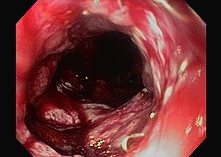
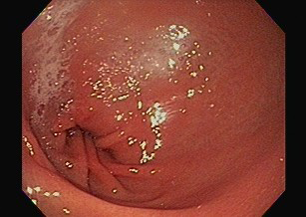
Case Presentation
Following treatment of site with 20sec cycles x 2 per site, total of 3 sites, endoscope able to pass

Slide 42
Summary
Endoscopic ablation therapy is indicated in only dysplastic Barrett’s
Nodules seen should be removed by EMR first
PDT not indicated due to cost and lower efficacy
APC effective for focal areas
Flat Barretts of LGD or HGD can be treated with RFA
Nodular Barretts of LGD, HGD, IMCa can be treated with cryoablation
Combined therapy with EMR and cryotherapy is a viable option for early esophageal cancer and HGD
Cryotherapy may be useful in palliation of dysphagia from esophageal carcinoma

Slide 43
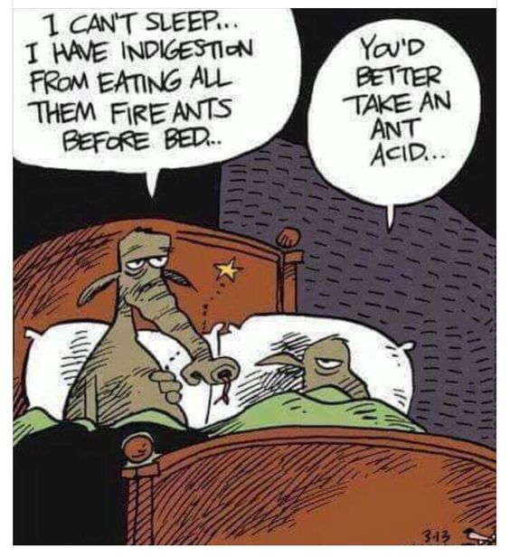

Slide 44
