Slide 1
ENDOSCOPIC MANAGEMENT OF ESOPHAGEAL FOREIGN BODIES AND FOOD IMPACTION

Slide 2
No Disclosures

Slide 3
80% of foreign objects will pass
Intentional ingestion, need endoscopic intervention in 60-75%
Peak incidence, 6 months to 6 years
GIE 73, No 6 : 2011; 1085-91

Slide 4
CONSERVATIVE MANAGEMENT OF FOREIGN BODIES
10 year experience with male prison inmates
Esophageal foreign bodies excluded
75 separate events in 22 male prisons
64 endoscopies with removal of 79 of 163 foreign bodies (48% success rate)
Weiland ST et al J Gastrointest Surg 2002 May-Jun; 6(3): 496-500

Slide 5
CONSERVATIVE MANAGEMENT OF FOREIGN BODIES
23 patient treated conservatively
77 of 79 foreign bodies passed spontaneously
Size, shape and number were not predictive of ability to transit GI tract
Weiland ST et al J Gastrointest Surg 2002 May-Jun; 6(3): 496-500

Slide 6
CONSERVATIVE MANAGEMENT OF FOREIGN BODIES
With conservative management most foreign bodies will pass spontaneously
Weiland ST et al J Gastrointest Surg 2002 May-Jun; 6(3): 496-500

Slide 7
PREDISPOSING FACTORS
Psychiatric disorders
Developmental delay
Alcohol intoxication
Incarcerated Individuals
Edentulous adults
Underlying esophageal pathology
GIE 73, No 6 : 2011; 1085-91

Slide 8
SYMPTOMS
Area of discomfort does not correlate with site of impaction
Symptoms may be delayed
Present with choking, refusal to eat, vomiting, drooling, wheezing or respiratory distress.
GIE 73, No 6 : 2011; 1085-91

Slide 9
SIGNS
Perforation – neck swelling, erythema, tenderness or crepitus
Peritonitis
Small bowel obstruction
GIE 73, No 6 : 2011; 1085-91

Slide 10
IMAGING
Biplane radiographs
foreign objects, steak bones, free mediastinal or peritoneal air)
Location, size, shape and number of foreign bodies
Exclude aspirated objects
Fish or chicken bones, wood, plastic, glass and thin metal objects not seen
Avoid contrast examination
Aspiration
Compromises subsequent endoscopy
GIE 73, No 6 : 2011; 1085-91

Slide 11
IMAGING
CT scan
- may be useful
- may not detect radiolucent objects
- 3 dimensional reconstruction
GIE 73, No 6 : 2011; 1085-91

Slide 12
MANAGEMENT
Airway management
aspiration risk
endotracheal intubation
GIE 73, No 6 : 2011; 1085-91

Slide 13
TIMING OF ENDOSCOPY
Emergent endoscopy
Esophageal obstruction
Disk batteries in esophagus
Sharp / pointed objects in esophagus
Urgent endoscopy
Esophageal foreign objects (not sharp)
Esophageal food impaction (not complete)
Sharp / pointed objects in stomach and duodenum
6 cm length at or above proximal duodenum
Magnets within endoscopic reach
GIE 73, No 6 : 2011; 1085-91

Slide 14
TIMING OF ENDOSCOPY
Nonurgent endoscopy
coins in esophagus, asymptomatic ( 12-24 hours)
objects in stomach > 2.5 cm
Disk and cylindrical batteries in stomach without GI injury, up to 48 hours

Slide 15
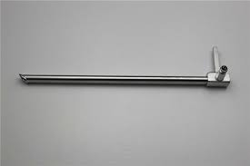
EQUIPMENT
Flexible endoscope
Rigid esophagoscope

Slide 16
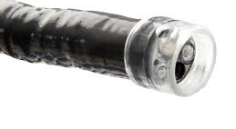
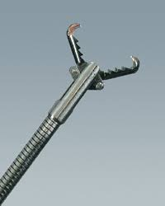
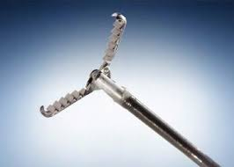
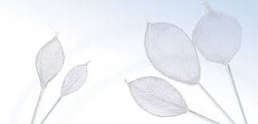
Accessories
Cap
Rat tooth forceps
Alligator forceps
Retrieval nets

Slide 17
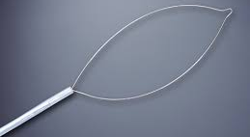
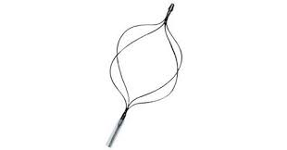
ACCESSORIES
Snare
Dormia Basket

Slide 18
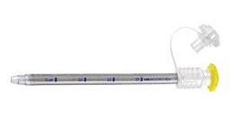
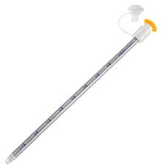
OVERTUBES

Slide 19
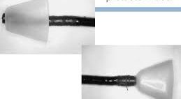
ACCESSORIES
Foreign Body Retrieval Hood Protector
Slideshare.net

Slide 20
FOOD BOLUS IMPACTION
Food extraction
Pushing bolus into stomach
GIE 73, No 6 : 2011; 1085-91

Slide 21
FOOD EXTRACTION
Snare
Retrieval net
Banding cap
Piecemeal removal
GIE 73, No 6 : 2011; 1085-91

Slide 22
PUSH vs REMOVAL
189 pts 1993-98
Schatzki’s ring 41%
Esophageal stricture 32%
Esophageal cancer 2%
No obvious cause 25%
Vicari et al GIE 2001;53:178-81

Slide 23
PUSH vs REMOVAL
Push technique effective in 97%
Gentle pressure. Reduction of bolus size by piecemeal removal.
No perforation, aspiration or bleeding
Dilation without complication at time of disimpaction 45 pts
Vicari et al GIE 2001;53:178-81

Slide 24
PUSH vs REMOVAL
Push technique recommended as initial therapy for acute esophageal food impaction
Dilation at time of esophageal food impaction can be considered
Vicari et al GIE 2001;53:178-81

Slide 25
FOOD IMPACTION
Caution after prolonged impaction and suspected EoE
Never use proteolytic enzymes, like papain. – hypernatremia, mucosal erosion and esophageal perforation
No emetics
GIE 73, No 6 : 2011; 1085-91

Slide 26
USE OF GLUCAGON
Spasmolytic which influences both striated and smooth muscle of esophagus
Multicenter placebo controlled double blind study
Glucagon and diazepam in 43 pts
Tibbling et al Dysphagia 1995 Spring;10(2): 126-7

Slide 27
USE OF GLUCAGON
9 of 23 given drug
6 of 19 given placebo
No significant difference
Response several hours later
Questionable effectiveness of spasmolytics
Tibbling et al Dysphagia 1995 Spring;10(2): 126-7

Slide 28
Use of Glucagon
Current recommendation
- Relatively safe
- Acceptable option
- Should not delay definitive endoscopic
therapy
GIE 73, No 6 : 2011; 1085-91

Slide 29
Foreign Bodies Short-blunt objects
Coins – forceps, snare or retrieval net
Smooth round objects – retrieval net or a basket
Wider than 2.5 cm, less likely to pass pylorus, endoscopic removal
GIE 73, No 6 : 2011; 1085-91

Slide 30
FOREIGN BODIES Short-blunt objects
Objects that fail to pass by 3-4 weeks, remove endoscopicaly
Surgery
Peritonitis
Distal to duodenum, cannot be reached endoscopicaly, no progression after 1 week.
GIE 73, No 6 : 2011; 1085-91

Slide 31
FOREIGN BODIES Long Objects
Longer than 6 cm – tooth brushes, eating utensils
Use of overtube (>45 cm)
Snare or basket
GIE 73, No 6 : 2011; 1085-91

Slide 32
FOREIGN BODIES Sharp-pointed objects
Esophagus- emergency
Stomach and duodenum- endoscopic removal
Beyond reach of endoscope, surgical removal
Failure to progress after 3 days
Complications – abdominal pain, vomiting, fever, GI bleed.
GIE 73, No 6 : 2011; 1085-91

Slide 33
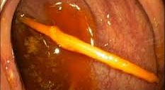
FOREIGN BODIES Sharp pointed objects

Slide 34
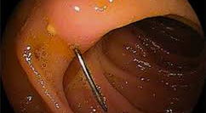
FOREIGN BODIES Sharp pointed objects
Researchgate.net

Slide 35
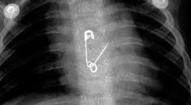
FOREIGN BODIES Sharp pointed objects
Sciencedirect.com

Slide 36
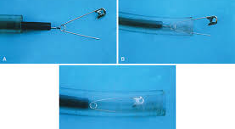
FOREIGN BODIES Sharp pointed objects
Veteriankey.com

Slide 37
FOREIGN BODIES Disk Batteries
In stomach, pass without complications
Exceptions
Signs of GI tract injury
Large diameter remaining in stomach for more than 48 hours
GIE 73, No 6 : 2011; 1085-91

Slide 38
FOREIGN BODIES Magnets
Risk of bowel necrosis with fistula formation, perforation, obstruction, volvulus or peritonitis
Removal of all magnets
GIE 73, No 6 : 2011; 1085-91

Slide 39
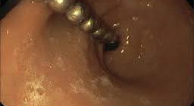
FOREIGN BODIES Magnets
Jdeonline.in

Slide 40
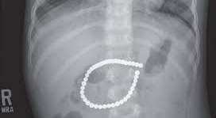
FOREIGN BODIES Magnets
Jdeonline.in

Slide 41
FOREIGN BODIES Coins
In esophagus, observe for 12-24 hours if asymptomatic
Drooling, chest pain and stridor – emergency
Most will leave the stomach
Pennies after 1982, massive ingestion, zinc toxicity.
GIE 73, No 6 : 2011; 1085-91

Slide 42
FOREIGN BODIES Narcotic packets
“Body Packing”
CT scan may be helpful
Endoscopic removal should not be attempted
Surgery
Failure to progress
Intestinal obstruction
Packet rupture is suspected
GIE 73, No 6 : 2011; 1085-91

Slide 43
FOREIGN BODIES Small bowel foreign objects
Single and double balloon enteroscopy
Retained video capsules
Hoods, baskets and forceps
GIE 73, No 6 : 2011; 1085-91

Slide 44
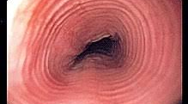
Management EoE
En.wikipedia.org

Slide 45
MANAGEMENT EoE
Diagnosis
Location of biopsies
Pathology
Treatment
6 food elimination diet – gluten, shellfish, milk, nuts, eggs, tofu.
PPI
Fluticasone inhaler
Dilation

Slide 46
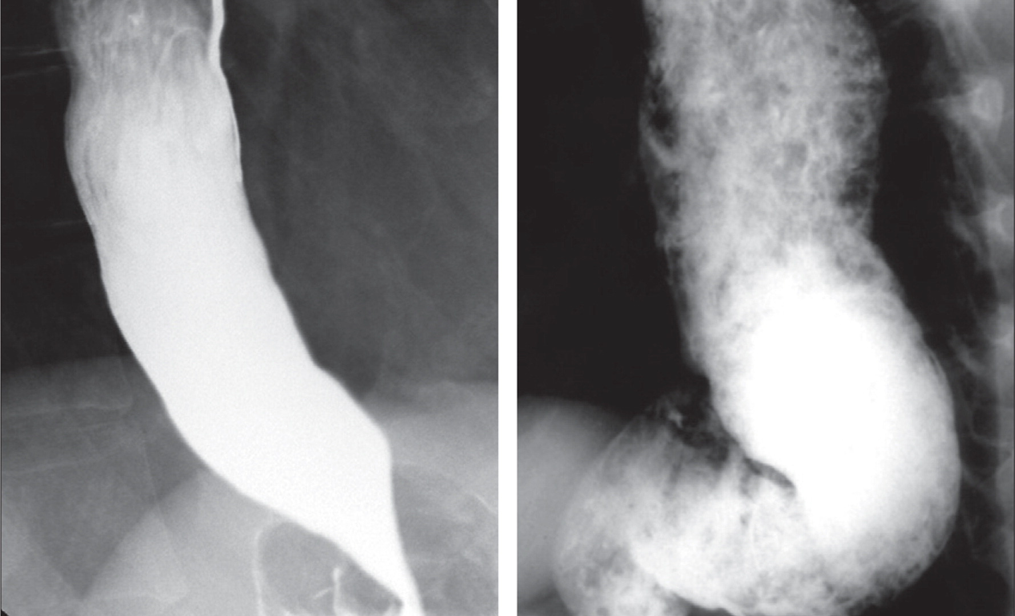
MANAGEMENT Achalasia
Lancet.com

Slide 47
MANAGEMENT Achalasia
Diagnosis
Radiology
Endoscopy
Manometry
Treatment
Medical
Endoscopic
Balloon dilation - Rigiflex
Botox injection
POEM (peroral endoscopic myotomy)

Slide 48
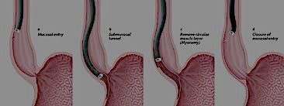
MANAGEMENT Achalasia
Mucosal entry
Submucosal tunnel
Myotomy
Closure of mucosal entry

Slide 49
MANAGEMENT Achalasia
Surgery
- Laparoscopic Hellers myotomy

Slide 50
MANAGEMENT Esophageal stricture/ring
Esophageal ring
Endoatlas.org

Slide 51
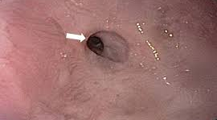
MANAGEMENT Esophageal stricture/ring
Esophageal Stricture
Acgcasereports.gi.org

Slide 52
MANAGEMENT Esophageal stricture/ring
Savary dilation
TTS ballon dilation
Rule of 3

Slide 53
PEPTIC STRICTURE TTS vs Savary dilation
34 patients. Equal number dilated with Savary dilator and TTS balloon
Both equally effective in relieving dysphagia
Saeed ZA et al GIE 1995;41(3):189

Slide 54
PEPTIC STRICTURE TTS vs Savary dilation
Recurrence similar in first year
During second year risk of recurrent dysphagia lower in patients with strictures dilated with balloons
Saeed ZA et al GIE 1995;41(3):189

Slide 55
CONCLUSION
Emergent removal of esophageal food bolus impactions and foreign bodies with complete esophageal obstruction
Endoscopic removal of all objects larger than 2.5 cm in stomach
Endoscopic removal of sharp-pointed objects or objects longer than 6 cm in the proximal duodenum or above
GIE 73, No 6 : 2011; 1085-91

Slide 56
CONCLUSION
Emergent removal of disk batteries in esophagus
Urgent removal of all magnets within endoscopic reach
GIE 73, No 6 : 2011; 1085-91

Slide 57
CONCLUSION
Coins within esophagus may be observed in asymptomatic patients. Remove within 24 hours of ingestion if no spontaneous passage
Do not attempt endoscopic removal of drug containing packets
GIE 73, No 6 : 2011; 1085-91

